Slide 1
Chapter 17
Software Testing Strategies
These slides are designed to accompany Software Engineering: A Practitioner’s Approach, 7/e (McGraw-Hill 2009). Slides copyright 2009 by Roger Pressman.

Slide 2
Software Testing
Testing is the process of exercising a program with the specific intent of finding errors prior to delivery to the end user.
These slides are designed to accompany Software Engineering: A Practitioner’s Approach, 7/e (McGraw-Hill 2009). Slides copyright 2009 by Roger Pressman.

Slide 3

What Testing Shows
errors
requirements conformance
performance
an indication
of quality
These slides are designed to accompany Software Engineering: A Practitioner’s Approach, 7/e (McGraw-Hill 2009). Slides copyright 2009 by Roger Pressman.

Slide 4
Strategic Approach to testing
To perform effective testing,conduct effective technical reviews,so that may errors will be eliminated before testing commences.
Testing begins at the component level and works "outward" toward the integration of the entire computer-based system.
Different testing techniques are appropriate for different software engineering approaches and at different points in time.
Testing is done by the developer ,For large projects(an independent test group).
These slides are designed to accompany Software Engineering: A Practitioner’s Approach, 7/e (McGraw-Hill 2009). Slides copyright 2009 by Roger Pressman.

Slide 5
Testing and debugging are different activities, but debugging must be accommodated in any testing strategy.
These slides are designed to accompany Software Engineering: A Practitioner’s Approach, 7/e (McGraw-Hill 2009). Slides copyright 2009 by Roger Pressman.

Slide 6
Good testing strategy
A strategy for software testing must accommodate low-level tests that are necessary to verify that a small source code segment has been correctly implemented as well as high-level tests that validate major system functions against customer requirements.
A strategy should provide guidance for the practitioner and a set of
milestones for the manager.
Because the steps of the test strategy occur at a time when deadline pressure begins to rise, progress must be measurable and problems should surface as early as possible.
These slides are designed to accompany Software Engineering: A Practitioner’s Approach, 7/e (McGraw-Hill 2009). Slides copyright 2009 by Roger Pressman.

Slide 7
V & V
Verification refers to the set of tasks that ensure that software correctly implements a specific function.
Validation refers to a different set of tasks that ensure that the software that has been built is traceable to customer requirements. Boehm [Boe81] states this another way:
  Verification: "Are we building the product right?"
  Validation: "Are we building the right product?"
These slides are designed to accompany Software Engineering: A Practitioner’s Approach, 7/e (McGraw-Hill 2009). Slides copyright 2009 by Roger Pressman.

Slide 8
V&V - software quality assurance activities
Technical reviews, quality and configuration audits, performance monitoring, simulation, feasibility study, documentation review, database review, algorithm analysis, development testing, usability testing, qualification testing, acceptance testing, and installation testing.
These slides are designed to accompany Software Engineering: A Practitioner’s Approach, 7/e (McGraw-Hill 2009). Slides copyright 2009 by Roger Pressman.

Slide 9


Who Tests the Software?
developer
independent tester
Understands the system
Must learn about the system,
but, will test "gently"
but, will attempt to break it
and, is driven by "delivery"
and, is driven by quality
These slides are designed to accompany Software Engineering: A Practitioner’s Approach, 7/e (McGraw-Hill 2009). Slides copyright 2009 by Roger Pressman.

Slide 10
misconceptions
The developer of software should do no testing
at all.
The software should be “tossed over the wall” to strangers who will
test it mercilessly
The testers get involved with the project only when the testing
steps are about to begin. Each of these statements is incorrect.
These slides are designed to accompany Software Engineering: A Practitioner’s Approach, 7/e (McGraw-Hill 2009). Slides copyright 2009 by Roger Pressman.

Slide 11
Role of the software developer
The software developer is always responsible for testing the individual units (components) of the program, ensuring that each performs the function or exhibits the behavior for which it was designed.
In many cases, the developer also conducts integration testing—a testing step that leads to the construction (and test) of the complete software architecture.
These slides are designed to accompany Software Engineering: A Practitioner’s Approach, 7/e (McGraw-Hill 2009). Slides copyright 2009 by Roger Pressman.

Slide 12
Role of Independent test group (ITG)
Only after the software architecture is complete does an independent test group become involved.
The role of an independent test group (ITG) is to remove the inherent problems associated with letting the builder test the thing that has been built.
Independent testing removes the conflict of interest that may otherwise be present.
After all, ITG personnel are paid to find errors.
These slides are designed to accompany Software Engineering: A Practitioner’s Approach, 7/e (McGraw-Hill 2009). Slides copyright 2009 by Roger Pressman.

Slide 13
The developer and the ITG work closely throughout a software project to ensure that thorough tests will be conducted.
While testing is conducted, the developer must be available to correct errors that are uncovered.
These slides are designed to accompany Software Engineering: A Practitioner’s Approach, 7/e (McGraw-Hill 2009). Slides copyright 2009 by Roger Pressman.

Slide 14
Testing Strategy
System engineering
Analysis modeling
Design modeling
Code generation
Unit test
Integration test
Validation test
System test
These slides are designed to accompany Software Engineering: A Practitioner’s Approach, 7/e (McGraw-Hill 2009). Slides copyright 2009 by Roger Pressman.

Slide 15
Testing Strategy
Initially, system engineering defines the role of software and leads to software requirements analysis, where the information domain, function, behavior, performance, constraints, and validation criteria for software are established.
Moving inward along the spiral, you come to design and finally to coding.
To develop computer software, you spiral inward (counterclockwise) along streamlines that decrease the level of abstraction on each turn.
These slides are designed to accompany Software Engineering: A Practitioner’s Approach, 7/e (McGraw-Hill 2009). Slides copyright 2009 by Roger Pressman.

Slide 16
Testing Strategy
Unit testing begins at the vertex of the spiral and concentrates on each unit (e.g., component, class, or WebApp content object) of the software as implemented in source code.
Testing progresses by moving outward along the spiral to integration testing, where the focus is on design and the construction of the software architecture.
These slides are designed to accompany Software Engineering: A Practitioner’s Approach, 7/e (McGraw-Hill 2009). Slides copyright 2009 by Roger Pressman.

Slide 17
Testing Strategy
Taking another turn outward on the spiral, you encounter validation testing, where requirements established as part of requirements modeling are validated against the software that has been constructed.
Finally, you arrive at system testing, where the software and other system elements are tested as a whole.
To test computer software, you spiral out in a clockwise direction along streamlines that broaden the scope of testing with each turn.
These slides are designed to accompany Software Engineering: A Practitioner’s Approach, 7/e (McGraw-Hill 2009). Slides copyright 2009 by Roger Pressman.

Slide 18
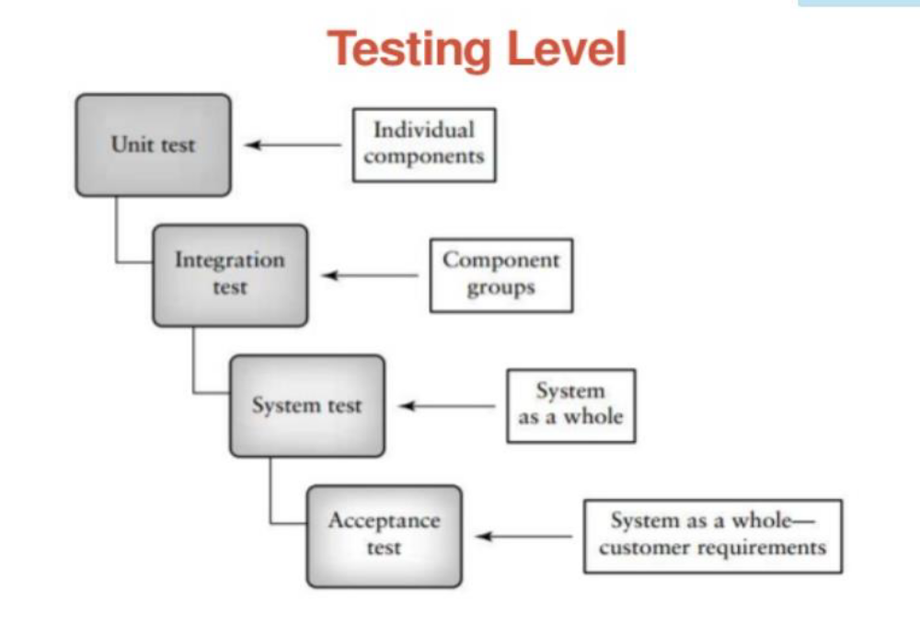

These slides are designed to accompany Software Engineering: A Practitioner’s Approach, 7/e (McGraw-Hill 2009). Slides copyright 2009 by Roger Pressman.

Slide 19
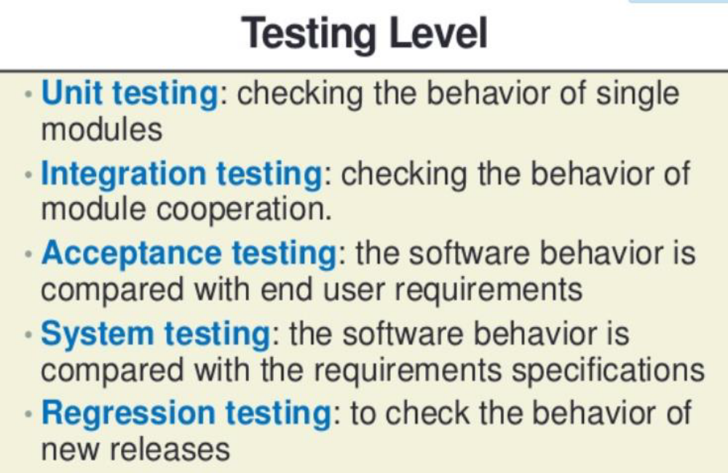
These slides are designed to accompany Software Engineering: A Practitioner’s Approach, 7/e (McGraw-Hill 2009). Slides copyright 2009 by Roger Pressman.

Slide 20
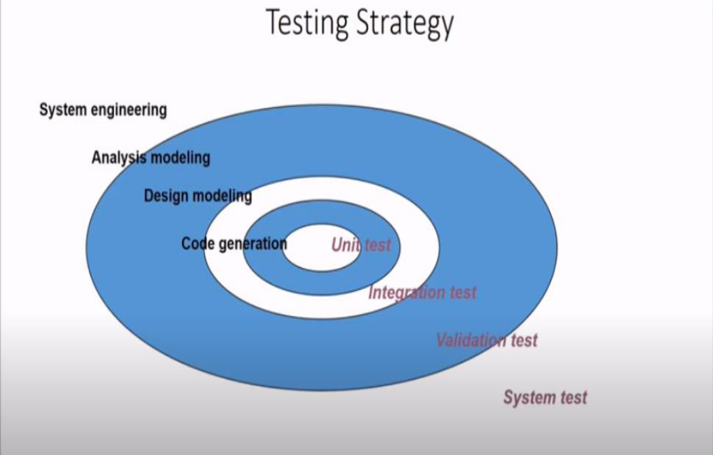
These slides are designed to accompany Software Engineering: A Practitioner’s Approach, 7/e (McGraw-Hill 2009). Slides copyright 2009 by Roger Pressman.

Slide 21
Testing Strategy
We begin by ‘testing-in-the-small’ and move toward ‘testing-in-the-large’
For conventional software
  The module (component) is our initial focus
  Integration of modules follows
For OO software
  our focus when “testing in the small” changes from an individual module (the conventional view) to an OO class that encompasses attributes and operations and implies communication and collaboration
These slides are designed to accompany Software Engineering: A Practitioner’s Approach, 7/e (McGraw-Hill 2009). Slides copyright 2009 by Roger Pressman.

Slide 22
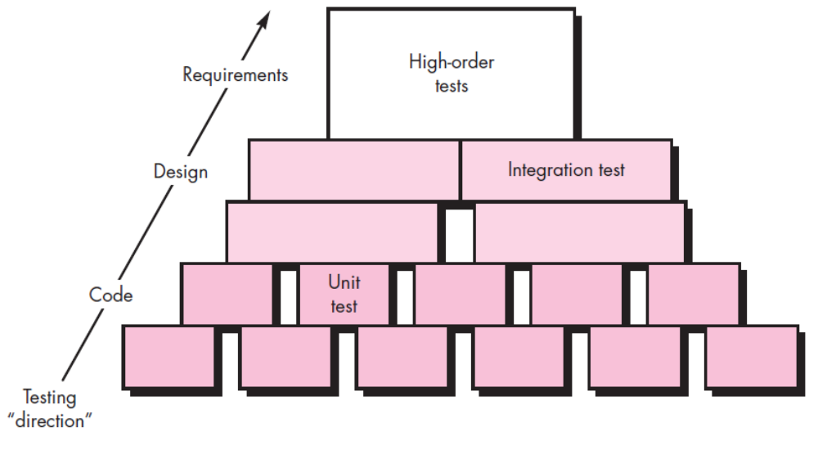
Software Testing steps
These slides are designed to accompany Software Engineering: A Practitioner’s Approach, 7/e (McGraw-Hill 2009). Slides copyright 2009 by Roger Pressman.

Slide 23
When are we done testing—how do we know that we’ve tested enough?”
These slides are designed to accompany Software Engineering: A Practitioner’s Approach, 7/e (McGraw-Hill 2009). Slides copyright 2009 by Roger Pressman.

Slide 24
Criteria for Completion of Testing
One response to the question is: “You’re never done testing; the burden simply shifts from you (the software engineer) to the end user.”
Every time the user executes a computer program, the program is being tested.
This sobering fact underlines the importance of other software quality assurance activities. Another response (somewhat cynical but nonetheless accurate) is: “You’re done testing when you run out of time or you run out of money.”
Although few practitioners would argue with these responses, you need more rigorous criteria for determining when sufficient testing has been conducted.
These slides are designed to accompany Software Engineering: A Practitioner’s Approach, 7/e (McGraw-Hill 2009). Slides copyright 2009 by Roger Pressman.

Slide 25
Criteria for Completion of Testing
By collecting metrics during software testing and making use of existing software reliability models, it is possible to develop meaningful guidelines for answering the question: “When are we done testing?” There is little debate that further work remains to be done before quantitative rules for testing can be established, but the empirical approaches that currently exist are considerably better than raw intuition
These slides are designed to accompany Software Engineering: A Practitioner’s Approach, 7/e (McGraw-Hill 2009). Slides copyright 2009 by Roger Pressman.

Slide 26
Strategic Issues
Specify product requirements in a quantifiable manner long before testing commences.
State testing objectives explicitly.
Understand the users of the software and develop a profile for each user category.
Develop a testing plan that emphasizes “rapid cycle testing.”
Build “robust” software that is designed to test itself
Use effective technical reviews as a filter prior to testing
Conduct technical reviews to assess the test strategy and test cases themselves.
Develop a continuous improvement approach for the testing process.
These slides are designed to accompany Software Engineering: A Practitioner’s Approach, 7/e (McGraw-Hill 2009). Slides copyright 2009 by Roger Pressman.

Slide 27
TEST STRATEGIES FOR CONVENTIONAL SOFTWARE
Unit Testing
Integration Testing
Regression Testing
Smoke Testing
These slides are designed to accompany Software Engineering: A Practitioner’s Approach, 7/e (McGraw-Hill 2009). Slides copyright 2009 by Roger Pressman.

Slide 28
Common Computational Errors in Execution Paths
Misunderstood or incorrect arithmetic precedence
Mixed mode operations (e.g., int, float, char)
Incorrect initialization of values
Precision inaccuracy and round-off errors
Incorrect symbolic representation of an expression (int vs. float)
These slides are designed to accompany Software Engineering: A Practitioner’s Approach, 7/e (McGraw-Hill 2009). Slides copyright 2009 by Roger Pressman.

Slide 29
Other Errors to Uncover
Comparison of different data types
Incorrect logical operators or precedence
Expectation of equality when precision error makes equality unlikely (using == with float types)
Incorrect comparison of variables
Improper or nonexistent loop termination
Failure to exit when divergent iteration is encountered
Improperly modified loop variables
Boundary value violations
These slides are designed to accompany Software Engineering: A Practitioner’s Approach, 7/e (McGraw-Hill 2009). Slides copyright 2009 by Roger Pressman.

Slide 30
Problems to uncover in Error Handling
Error description is unintelligible or ambiguous
Error noted does not correspond to error encountered
Error condition causes operating system intervention prior to error handling
Exception condition processing is incorrect
Error description does not provide enough information to assist in the location of the cause of the error
These slides are designed to accompany Software Engineering: A Practitioner’s Approach, 7/e (McGraw-Hill 2009). Slides copyright 2009 by Roger Pressman.

Slide 31
Unit Testing
Unit testing focuses verification effort on the smallest unit of software design—the software component or module.
Using the component-level design description as a guide, important control paths are tested to uncover errors within the boundary of the module.
These slides are designed to accompany Software Engineering: A Practitioner’s Approach, 7/e (McGraw-Hill 2009). Slides copyright 2009 by Roger Pressman.

Slide 32
Unit Testing
The relative complexity of tests and the errors those tests uncover is limited by the constrained scope established for unit testing.
The unit test focuses on the internal processing logic and data structures within the boundaries of a component.
This type of testing can be conducted in parallel for multiple components
These slides are designed to accompany Software Engineering: A Practitioner’s Approach, 7/e (McGraw-Hill 2009). Slides copyright 2009 by Roger Pressman.

Slide 33


Unit Testing
module
to be
tested
results
software
engineer
test cases
These slides are designed to accompany Software Engineering: A Practitioner’s Approach, 7/e (McGraw-Hill 2009). Slides copyright 2009 by Roger Pressman.

Slide 34
Unit Testing
module
to be
tested
interface
local data structures
boundary conditions
independent paths
error handling paths
test cases
These slides are designed to accompany Software Engineering: A Practitioner’s Approach, 7/e (McGraw-Hill 2009). Slides copyright 2009 by Roger Pressman.

Slide 35
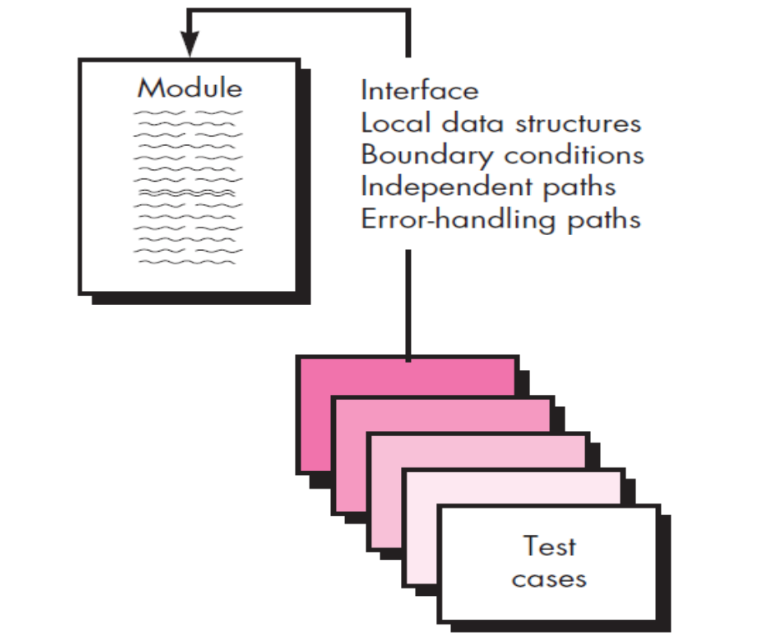
Unit-test considerations
These slides are designed to accompany Software Engineering: A Practitioner’s Approach, 7/e (McGraw-Hill 2009). Slides copyright 2009 by Roger Pressman.

Slide 36
Unit-test considerations
The module interface is tested to ensure that information properly flows into and out of the program unit under test.
Local data structures are examined to ensure that data stored temporarily maintains its integrity during all steps in an algorithm’s
execution.
These slides are designed to accompany Software Engineering: A Practitioner’s Approach, 7/e (McGraw-Hill 2009). Slides copyright 2009 by Roger Pressman.

Slide 37
Unit-test considerations
All independent paths through the control structure are exercised to ensure that all statements in a module have been executed at least once.
Boundary conditions are tested to ensure that the module operates properly at boundaries established to limit or restrict processing.
And finally, all error-handling paths are tested.
Data flow across a component interface is tested before any other testing is initiated.
These slides are designed to accompany Software Engineering: A Practitioner’s Approach, 7/e(McGraw-Hill 2009). Slides copyright 2009 by Roger Pressman.

Slide 38
Unit-test considerations
If data do not enter and exit properly, all other tests are moot. In addition, local data structures should be exercised and the local impact on global data should be ascertained (if possible) during unit testing.
Selective testing of execution paths is an essential task during the unit test.
Test cases should be designed to uncover errors due to erroneous computations, incorrect comparisons, or improper control flow.
These slides are designed to accompany Software Engineering: A Practitioner’s Approach, 7/e (McGraw-Hill 2009). Slides copyright 2009 by Roger Pressman.

Slide 39
Unit-test considerations
Boundary testing is one of the most important unit testing tasks.
Software often fails at its boundaries.
That is, errors often occur when the nth element of an n-dimensional array is processed, when the ith repetition of a loop with i passes is invoked, when the maximum or minimum allowable value is encountered.
Test cases that exercise data structure, control flow, and data values just below, at, and
just above maxima and minima are very likely to uncover errors
These slides are designed to accompany Software Engineering: A Practitioner’s Approach, 7/e (McGraw-Hill 2009). Slides copyright 2009 by Roger Pressman.

Slide 40
A good design anticipates error conditions and establishes error-handling paths to reroute or cleanly terminate processing when an error does occur.
These slides are designed to accompany Software Engineering: A Practitioner’s Approach, 7/e (McGraw-Hill 2009). Slides copyright 2009 by Roger Pressman.

Slide 41
potential errors that should be tested
error description is unintelligible,
error noted does not correspond to
error encountered,
error condition causes system intervention prior to error handling,
exception-condition processing is incorrect,
error description does not provide enough information to assist in the location of the cause of the error.
These slides are designed to accompany Software Engineering: A Practitioner’s Approach, 7/e (McGraw-Hill 2009). Slides copyright 2009 by Roger Pressman.

Slide 42
Unit-test procedures
Unit testing is normally considered as an adjunct to the coding step.
The design of unit tests can occur before coding begins or after source code has been generated.
A review of design information provides guidance for establishing test cases that are likely to uncover errors in each of the categories discussed earlier.
Each test case should be coupled with a set of expected results.
These slides are designed to accompany Software Engineering: A Practitioner’s Approach, 7/e (McGraw-Hill 2009). Slides copyright 2009 by Roger Pressman.

Slide 43
Unit-test procedures
Because a component is not a stand-alone program, driver and/or stub software must often be developed for each unit test.
These slides are designed to accompany Software Engineering: A Practitioner’s Approach, 7/e (McGraw-Hill 2009). Slides copyright 2009 by Roger Pressman.

Slide 44
Unit Test Environment
driver
interface
local data structures
Module
boundary conditions
independent paths
error handling paths
stub
stub
test cases
RESULTS
These slides are designed to accompany Software Engineering: A Practitioner’s Approach, 7/e (McGraw-Hill 2009). Slides copyright 2009 by Roger Pressman.

Slide 45
Unit Test Environment
In most applications a driver is nothing more than a “main program” that accepts test case data, passes such data to the component (to be tested), and prints relevant results.
These slides are designed to accompany Software Engineering: A Practitioner’s Approach, 7/e (McGraw-Hill 2009). Slides copyright 2009 by Roger Pressman.

Slide 46
Stubs
Stubs serve to replace modules that are subordinate (invoked by) the component to be tested.
A stub or “dummy subprogram” uses the subordinate module’s interface, may do minimal data manipulation, prints verification of entry, and returns control to the module undergoing testing.
These slides are designed to accompany Software Engineering: A Practitioner’s Approach, 7/e (McGraw-Hill 2009). Slides copyright 2009 by Roger Pressman.

Slide 47
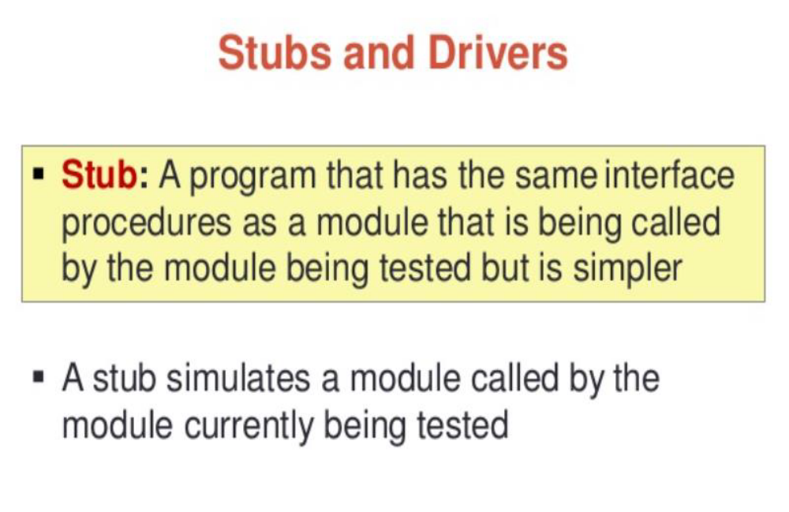
These slides are designed to accompany Software Engineering: A Practitioner’s Approach, 7/e (McGraw-Hill 2009). Slides copyright 2009 by Roger Pressman.

Slide 48
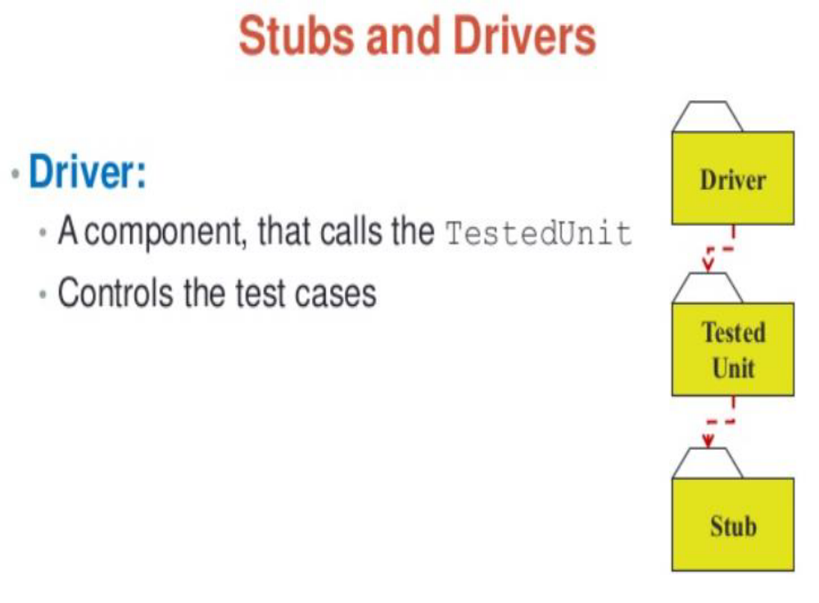
These slides are designed to accompany Software Engineering: A Practitioner’s Approach, 7/e (McGraw-Hill 2009). Slides copyright 2009 by Roger Pressman.

Slide 49
Drivers and Stubs for Unit Testing
•Driver
•A simple main program that accepts test case data, passes such data to the component being tested, and prints the returned results
•
These slides are designed to accompany Software Engineering: A Practitioner’s Approach, 7/e (McGraw-Hill 2009). Slides copyright 2009 by Roger Pressman.

Slide 50
Drivers and Stubs for Unit Testing
Stubs
•Serve to replace modules that are subordinate to (called by) the component to be tested
•It uses the module’s exact interface, may do minimal data manipulation, provides verification of entry, and returns control to the module undergoing testing
•
These slides are designed to accompany Software Engineering: A Practitioner’s Approach, 7/e (McGraw-Hill 2009). Slides copyright 2009 by Roger Pressman.

Slide 51
These slides are designed to accompany Software Engineering: A Practitioner’s Approach, 7/e (McGraw-Hill 2009). Slides copyright 2009 by Roger Pressman.

Slide 52
Drivers and Stubs for Unit Testing
Drivers and stubs both represent overhead
Both must be written but don’t constitute part of the installed software .
If drivers and stubs are kept simple, actual overhead is relatively low. Unfortunately, many components cannot be adequately unit tested with “simple” overhead software.
These slides are designed to accompany Software Engineering: A Practitioner’s Approach, 7/e (McGraw-Hill 2009). Slides copyright 2009 by Roger Pressman.

Slide 53
In such cases, complete testing can be postponed until the integration test step (where drivers or stubs are also used).
Unit testing is simplified when a component with high cohesion is designed.
When only one function is addressed by a component, the number of test cases is reduced and errors can be more easily predicted and uncovered.
These slides are designed to accompany Software Engineering: A Practitioner’s Approach, 7/e (McGraw-Hill 2009). Slides copyright 2009 by Roger Pressman.

Slide 54

Integration Testing Strategies
Options:
  • the “big bang” approach
  • an incremental construction strategy
These slides are designed to accompany Software Engineering: A Practitioner’s Approach, 7/e (McGraw-Hill 2009). Slides copyright 2009 by Roger Pressman.

Slide 55
Integration testing
Integration testing is a systematic technique for constructing the software architecture while at the same time conducting tests to uncover errors associated with interfacing.
The objective is to take unit-tested components and build a program
structure that has been dictated by design
These slides are designed to accompany Software Engineering: A Practitioner’s Approach, 7/e (McGraw-Hill 2009). Slides copyright 2009 by Roger Pressman.

Slide 56
Top-down integration testing
Top-down integration testing is an incremental approach to construction of the software architecture.
Modules are integrated by moving downward through the control hierarchy, beginning with the main control module
There are some situations in which you will
not have the resources to do comprehensive unit testing.
Select critical or complex modules and unit test
only those.
These slides are designed to accompany Software Engineering: A Practitioner’s Approach, 7/e (McGraw-Hill 2009). Slides copyright 2009 by Roger Pressman.

Slide 57
Modules subordinate (and ultimately subordinate) to the main control module are incorporated into the structure in either a depth-first or breadth-first manner.
These slides are designed to accompany Software Engineering: A Practitioner’s Approach, 7/e (McGraw-Hill 2009). Slides copyright 2009 by Roger Pressman.

Slide 58
Top-down integration testing
depth-first integration integrates all components on a
major control path of the program structure. Selection of a major path is somewhat arbitrary and depends on application-specific characteristics.
For example, selecting the left-hand path, components M1, M2 , M5 would be integrated first. Next, M8 or (if necessary for proper functioning of M2) M6 would be integrated.
Then, the central and right-hand control paths are built. Breadth-first integration incorporates all components directly subordinate at each level, moving across the structure horizontally.
From the figure, components M2, M3, and M4 would be integrated first. The next control level, M5, M6, and so on, follows.
These slides are designed to accompany Software Engineering: A Practitioner’s Approach, 7/e (McGraw-Hill 2009). Slides copyright 2009 by Roger Pressman.

Slide 59
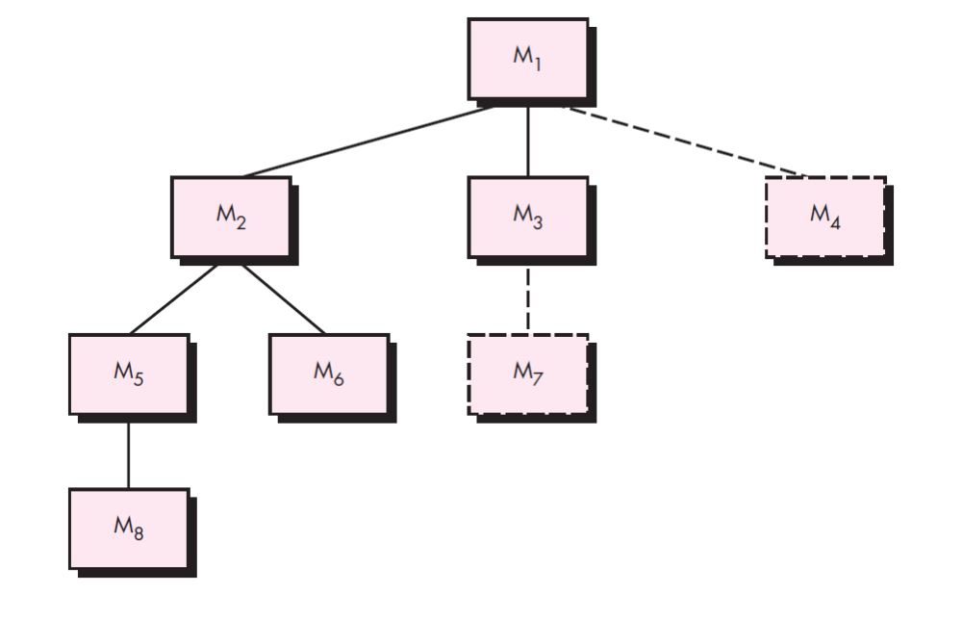
Top-down integration testing
These slides are designed to accompany Software Engineering: A Practitioner’s Approach, 7/e (McGraw-Hill 2009). Slides copyright 2009 by Roger Pressman.

Slide 60
Top-down integration testing
1. The main control module is used as a test driver and stubs are substituted for
all components directly subordinate to the main control module.
2. Depending on the integration approach selected (i.e., depth or breadth first),
subordinate stubs are replaced one at a time with actual components.
3. Tests are conducted as each component is integrated.
4. On completion of each set of tests, another stub is replaced with the real
component.
5. Regression testing may be conducted to
ensure that new errors have not been introduced.
These slides are designed to accompany Software Engineering: A Practitioner’s Approach, 7/e (McGraw-Hill 2009). Slides copyright 2009 by Roger Pressman.

Slide 61
The top-down integration strategy verifies major control or decision points early in the test process.
In a “well-factored” program structure, decision making occurs at upper levels in the hierarchy and is therefore encountered first.
If major control problems do exist, early recognition is essential.
If depth-first integration is selected, a complete function of the software may be implemented and demonstrated.
These slides are designed to a ccompany Software Engineering: A Practitioner’s Approach, 7/e (McGraw-Hill 2009). Slides copyright 2009 by Roger Pressman.

Slide 62
Early demonstration of functional capability is a confidence builder for all stakeholders
These slides are designed to accompany Software Engineering: A Practitioner’s Approach, 7/e (McGraw-Hill 2009). Slides copyright 2009 by Roger Pressman.

Slide 63
Top-down strategy sounds relatively uncomplicated, but in practice, logistical
problems can arise.
The most common of these problems occurs when processing at low levels in the hierarchy is required to adequately test upper levels.
Stubs replace low-level modules at the beginning of top-down testing; therefore, no significant data can flow upward in the program structure.
These slides are designed to accompany Software Engineering: A Practitioner’s Approach, 7/e (McGraw-Hill 2009). Slides copyright 2009 by Roger Pressman.

Slide 64
As a tester, you are left with three choices: (1) delay many tests until stubs are replaced with actual modules, (2) develop stubs that perform limited functions that simulate the actual module, or (3) integrate the software from the bottom of the hierarchy upward
These slides are designed to accompany Software Engineering: A Practitioner’s Approach, 7/e (McGraw-Hill 2009). Slides copyright 2009 by Roger Pressman.

Slide 65
The first approach (delay tests until stubs are replaced by actual modules) can cause you to lose some control over correspondence between specific tests and incorporation of specific modules.
This can lead to difficulty in determining the cause of errors and tends to violate the highly constrained nature of the top-down approach.
The second approach is workable but can lead to significant overhead, as stubs become more and more complex.
These slides are designed to accompany Software Engineering: A Practitioner’s Approach, 7/e (McGraw-Hill 2009). Slides copyright 2009 by Roger Pressman.

Slide 66
Top Down Integration
A
top module is tested with
stubs
B
F
G
stubs are replaced one at
a time, "depth first"
C
as new modules are integrated,
some subset of tests is re-run
D
E
These slides are designed to accompany Software Engineering: A Practitioner’s Approach, 7/e (McGraw-Hill 2009). Slides copyright 2009 by Roger Pressman.

Slide 67
Bottom-up integration testing, as its name implies, begins
construction and testing with atomic modules (i.e., components at the lowest levels in the program structure). Because components are integrated from the bottom up,the functionality provided by components subordinate to a given level is always available and the need for stubs is eliminated.
These slides are designed to accompany Software Engineering: A Practitioner’s Approach, 7/e (McGraw-Hill 2009). Slides copyright 2009 by Roger Pressman.

Slide 68
1. Low-level components are combined into clusters (sometimes called builds) that perform a specific software subfunction.
2. A driver (a control program for testing) is written to coordinate test case input and output.
3. The cluster is tested.
4. Drivers are removed and clusters are combined moving upward in the program structure.
These slides are designed to accompany Software Engineering: A Practitioner’s Approach, 7/e (McGraw-Hill 2009). Slides copyright 2009 by Roger Pressman.

Slide 69
Components are combined to form clusters 1, 2, and 3. Each of the clusters is tested using a driver (shown as a dashed block). Components in clusters 1 and 2 are subordinate to Ma.
Drivers D1 and D2 are removed and the clusters are interfaced directly to Ma. Similarly, driver D3 for cluster 3 is removed prior to integration with module Mb. Both Ma and Mb will ultimately be integrated with component Mc, and so forth.
These slides are designed to accompany Software Engineering: A Practitioner’s Approach, 7/e (McGraw-Hill 2009). Slides copyright 2009 by Roger Pressman.

Slide 70
Bottom-Up Integration
A
B
F
G
drivers are replaced one at a
time, "depth first"
C
worker modules are grouped into
builds and integrated
D
E
cluster
These slides are designed to accompany Software Engineering: A Practitioner’s Approach, 7/e (McGraw-Hill 2009). Slides copyright 2009 by Roger Pressman.

Slide 71
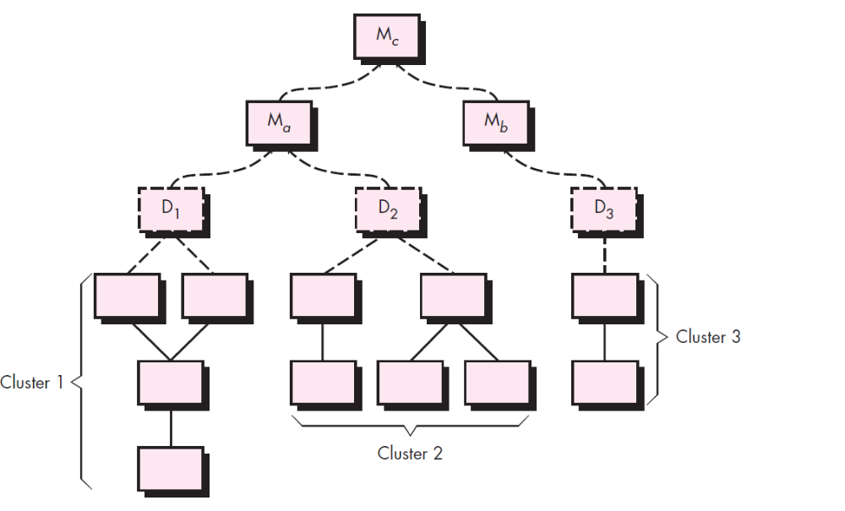
Bottom-Up Integration
These slides are designed to accompany Software Engineering: A Practitioner’s Approach, 7/e (McGraw-Hill 2009). Slides copyright 2009 by Roger Pressman.

Slide 72
Components are combined to form clusters 1, 2, and 3. Each of the clusters is tested using a driver (shown as a dashed block).
Components in clusters 1 and 2 are subordinate to Ma.
Drivers D1 and D2 are removed and the clusters are interfaced directly to Ma.
Similarly, driver D3 for cluster 3 is removed prior to integration with module Mb.
Both Ma and Mb will ultimately be integrated with component Mc, and so forth.
These slides are designed to accompany Software Engineering: A Practitioner’s Approach, 7/e (McGraw-Hill 2009). Slides copyright 2009 by Roger Pressman.

Slide 73
As integration moves upward, the need for separate test drivers lessens.
In fact, if the top two levels of program structure are integrated top down, the number of drivers can be reduced substantially and integration of clusters is greatly simplified.
These slides are designed to accompany Software Engineering: A Practitioner’s Approach, 7/e (McGraw-Hill 2009). Slides copyright 2009 by Roger Pressman.

Slide 74
Regression Testing
Regression testing is the re-execution of some subset of tests that have already been conducted to ensure that changes have not propagated unintended side effects
Whenever software is corrected, some aspect of the software configuration (the program, its documentation, or the data that support it) is changed.
Regression testing helps to ensure that changes (due to testing or for other reasons) do not introduce unintended behavior or additional errors.
Regression testing may be conducted manually, by re-executing a subset of all test cases or using automated capture/playback tools.
These slides are designed to accompany Software Engineering: A Practitioner’s Approach, 7/e (McGraw-Hill 2009). Slides copyright 2009 by Roger Pressman.

Slide 75
Regression test suite
A representative sample of tests that will exercise all software functions.
Additional tests that focus on software functions that are likely to be affected by the change.
Tests that focus on the software components that have been changed.
These slides are designed to accompany Software Engineering: A Practitioner’s Approach, 7/e (McGraw-Hill 2009). Slides copyright 2009 by Roger Pressman.

Slide 76
As integration testing proceeds, the number of regression tests can grow quite large. Therefore, the regression test suite should be designed to include only those tests that address one or more classes of errors in each of the major program functions.
It is impractical and inefficient to reexecute every test for every program function once a change has occurred.
These slides are designed to accompany Software Engineering: A Practitioner’s Approach, 7/e (McGraw-Hill 2009). Slides copyright 2009 by Roger Pressman.

Slide 77
Smoke testing
Smoke testing is an integration testing approach that is commonly used when product software is developed.
It is designed as a pacing mechanism for time-critical projects, allowing the software team to assess the project on a frequent basis.
These slides are designed to accompany Software Engineering: A Practitioner’s Approach, 7/e (McGraw-Hill 2009). Slides copyright 2009 by Roger Pressman.

Slide 78
Smoke Testing steps
A common approach for creating “daily builds” for product software
Smoke testing steps:
  Software components that have been translated into code are integrated into a “build.”
    A build includes all data files, libraries, reusable modules, and engineered components that are required to implement one or more product functions.
  A series of tests is designed to expose errors that will keep the build from properly performing its function.
    The intent should be to uncover “show stopper” errors that have the highest likelihood of throwing the software project behind schedule.
  The build is integrated with other builds and the entire product (in its current form) is smoke tested daily.
    The integration approach may be top down or bottom up.
These slides are designed to accompany Software Engineering: A Practitioner’s Approach, 7/e (McGraw-Hill 2009). Slides copyright 2009 by Roger Pressman.

Slide 79
Smoke Testing
The smoke test should exercise the entire system from end to end.
It does not have to be exhaustive, but it should be capable of exposing major problems.
The smoke test shouldbe thorough enough that if the build passes, you can assume that it is stable enough to be tested more thoroughly.
These slides are designed to accompany Software Engineering: A Practitioner’s Approach, 7/e (McGraw-Hill 2009). Slides copyright 2009 by Roger Pressman.

Slide 80
Benefits
Smoke testing provides a number of benefits when it is applied on complex, timecritical software projects:
These slides are designed to accompany Software Engineering: A Practitioner’s Approach, 7/e (McGraw-Hill 2009). Slides copyright 2009 by Roger Pressman.

Slide 81
Integration risk is minimized. Because smoke tests are conducted daily,
incompatibilities and other show-stopper errors are uncovered early, thereby reducing the likelihood of serious schedule impact when errors are uncovered.
These slides are designed to accompany Software Engineering: A Practitioner’s Approach, 7/e (McGraw-Hill 2009). Slides copyright 2009 by Roger Pressman.

Slide 82
The quality of the end product is improved. Because the approach is construction (integration) oriented, smoke testing is likely to uncover functional errors as well as architectural and component-level design errors.
If these errors are corrected early, better product quality will result.
These slides are designed to accompany Software Engineering: A Practitioner’s Approach, 7/e (McGraw-Hill 2009). Slides copyright 2009 by Roger Pressman.

Slide 83
Smoke testing
Smoke testing might be characterized as a
rolling integration strategy.
The software is rebuilt (with new components added) and smoke tested every day.
These slides are designed to accompany Software Engineering: A Practitioner’s Approach, 7/e (McGraw-Hill 2009). Slides copyright 2009 by Roger Pressman.

Slide 84
Smoke testing
Error diagnosis and correction are simplified. Like all integration testing approaches, errors uncovered during smoke testing are likely to be associated with “new software increments”—that is, the software that has just been added to the build(s) is a probable cause of a newly discovered error.
Progress is easier to assess. With each passing day, more of the software has been integrated and more has been demonstrated to work.
These slides are designed to accompany Software Engineering: A Practitioner’s Approach, 7/e (McGraw-Hill 2009). Slides copyright 2009 by Roger Pressman.

Slide 85
Smoke testing
This improves team morale and gives managers a good indication that progress is being made.
These slides are designed to accompany Software Engineering: A Practitioner’s Approach, 7/e (McGraw-Hill 2009). Slides copyright 2009 by Roger Pressman.

Slide 86
Strategic options/
The major disadvantage of the top-down approach is the need for stubs and the attendant testing difficulties that can be associated with them.
Problems associated with stubs may be offset by the advantage of testing major control
functions early.
The major disadvantage of bottom-up integration is that “the program as an entity does not exist until the last module is added” .
This drawback is tempered by easier test case design and a lack of stubs.
These slides are designed to accompany Software Engineering: A Practitioner’s Approach, 7/e (McGraw-Hill 2009). Slides copyright 2009 by Roger Pressman.

Slide 87
Strategic options
Selection of an integration strategy depends upon software characteristics and,
sometimes, project schedule. In general, a combined approach (sometimes called
sandwich testing) that uses top-down tests for upper levels of the program structure,
coupled with bottom-up tests for subordinate levels may be the best compromise
These slides are designed to accompany Software Engineering: A Practitioner’s Approach, 7/e (McGraw-Hill 2009). Slides copyright 2009 by Roger Pressman.

Slide 88
Strategic options
As integration testing is conducted, the tester should identify critical modules.
A critical module has one or more of the following characteristics: (1) addresses several
software requirements, (2) has a high level of control (resides relatively high in the
program structure), (3) is complex or error prone, or (4) has definite performance
requirements. Critical modules should be tested as early as is possible. In addition,
regression tests should focus on critical module function.
These slides are designed to accompany Software Engineering: A Practitioner’s Approach, 7/e (McGraw-Hill 2009). Slides copyright 2009 by Roger Pressman.

Slide 89
Integration test work products
An overall plan for integration of the software
and a description of specific tests is documented in a Test Specification.
This work product incorporates a test plan and a test procedure and becomes part of the software configuration.
Testing is divided into phases and builds that address specific functional and behavioral characteristics of the software.
These slides are designed to accompany Software Engineering: A Practitioner’s Approach, 7/e (McGraw-Hill 2009). Slides copyright 2009 by Roger Pressman.

Slide 90
Example
User interaction (command input and output, display representation, error processing and representation)
Sensor processing (acquisition of sensor output, determination of sensor conditions, actions required as a consequence of conditions)
Communications functions (ability to communicate with central monitoring
station)
Alarm processing (tests of software actions that occur when an alarm is encountered)
These slides are designed to accompany Software Engineering: A Practitioner’s Approach, 7/e (McGraw-Hill 2009). Slides copyright 2009 by Roger Pressman.

Slide 91
Each of these integration test phases delineates a broad functional category
within the software and generally can be related to a specific domain within the software
architecture. Therefore, program builds (groups of modules) are created to correspond
to each phase.
These slides are designed to accompany Software Engineering: A Practitioner’s Approach, 7/e (McGraw-Hill 2009). Slides copyright 2009 by Roger Pressman.

Slide 92
criteria and corresponding tests are applied for all test phases:
Internal and external interfaces are tested as each module (or cluster) is incorporated into the structure.
Functional validity. Tests designed to uncover functional errors are conducted.
Information content. Tests designed to uncover errors associated with local or global data structures are conducted.
Performance. Tests designed to verify performance bounds established during
software design are conducted.
These slides are designed to accompany Software Engineering: A Practitioner’s Approach, 7/e (McGraw-Hill 2009). Slides copyright 2009 by Roger Pressman.

